Slide 1
Machine Maintenance &
Motor Diagnostic System
A Z-Score Based Real-Time Anomaly Detection Approach for Predictive Maintenance
ESP32 · FastAPI · Streamlit · Plotly.js · Statistical Z-Score Engine
B.Tech Second Year Minor Project | Department of Mechanical Engineering

Slide 2
ABSTRACT
Project Abstract
Overview of the system design, methodology, and impact
Objective Design and implement a real-time predictive maintenance system for industrial motors using statistical vibration analysis, minimizing unplanned downtime through early-stage fault detection. Approach An ESP32 microcontroller equipped with an MPU-6050 IMU continuously streams tri-axial acceleration data. A FastAPI backend ingests the data, applies Z-Score normalization against a calibrated baseline, and flags statistically significant deviations as mechanical anomalies. Key Outcome A zero-training-required, computationally lightweight diagnostic engine deployable across heterogeneous industrial machinery with a single 1000-sample calibration phase.
2 / 12

Slide 3
PROBLEM
Problem Statement
The industrial cost of reactive maintenance paradigms
!
Reactive Maintenance
Machines are serviced only after failure occurs, resulting in costly unplanned downtime and potential safety hazards in production environments.
~
Scheduled Over-Maintenance
Time-based schedules lead to unnecessary component replacements, wasting resources on parts that remain within acceptable operating parameters.
?
Lack of Real-Time Insight
Operators lack continuous visibility into machine health metrics, making early-stage fault signatures (vibration shift, bearing wear onset) undetectable.
3 / 12

Slide 4
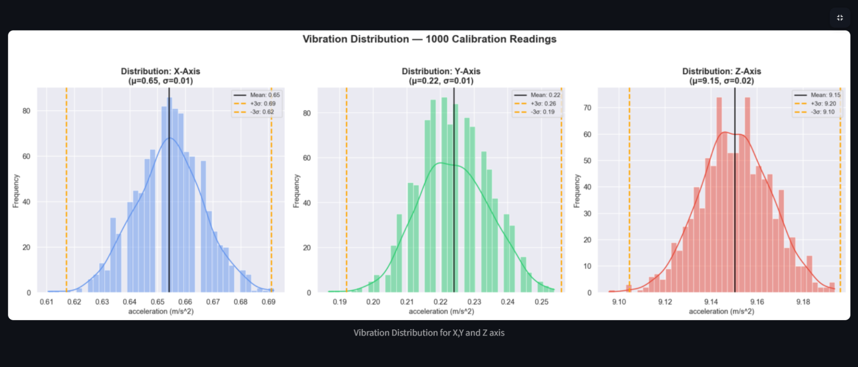

Slide 5
MATHEMATICS
Mathematical Formulation
Z-Score statistical anomaly detection — step-by-step
Step 1
Step 2
Calibration — Baseline Mean
Calibration — Standard Deviation
μ = (1/N) · Σ |xᵢ|
σ = √( (1/N) · Σ (|xᵢ| − μ)² )
Compute the population mean of N = 1000 absolute vibration readings per axis during a verified healthy operational state.
Compute the population standard deviation, representing the expected spread of healthy vibration amplitudes around μ.
Step 3
Step 4
Real-Time Z-Score
Anomaly Decision Rule
Z = (|x| − μ) / σ
|Z| > 3 → ANOMALY
For each incoming live reading, compute Z — the number of standard deviations the reading lies from the calibrated baseline mean.
Apply the 3-Sigma Empirical Rule. Readings beyond ±3σ have < 0.3% probability of occurrence under normal conditions, flagging a fault.
6 / 12

Slide 6
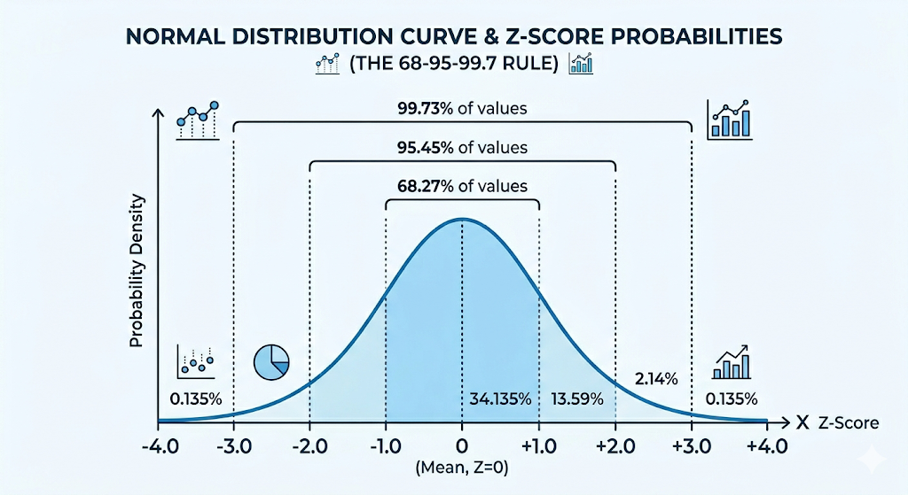
THEORY
The Empirical Rule — 3-Sigma Boundary
Probability basis of the anomaly threshold
|z|<1
68.27%
Normal operation — expected variance
|z|<2
95.45%
Marginal — monitor more closely
|z|<3
99.73%
Safe boundary — 3σ threshold applied
|z|>3
0.27%
ANOMALY — statistically improbable under normal operation
7 / 12

Slide 7

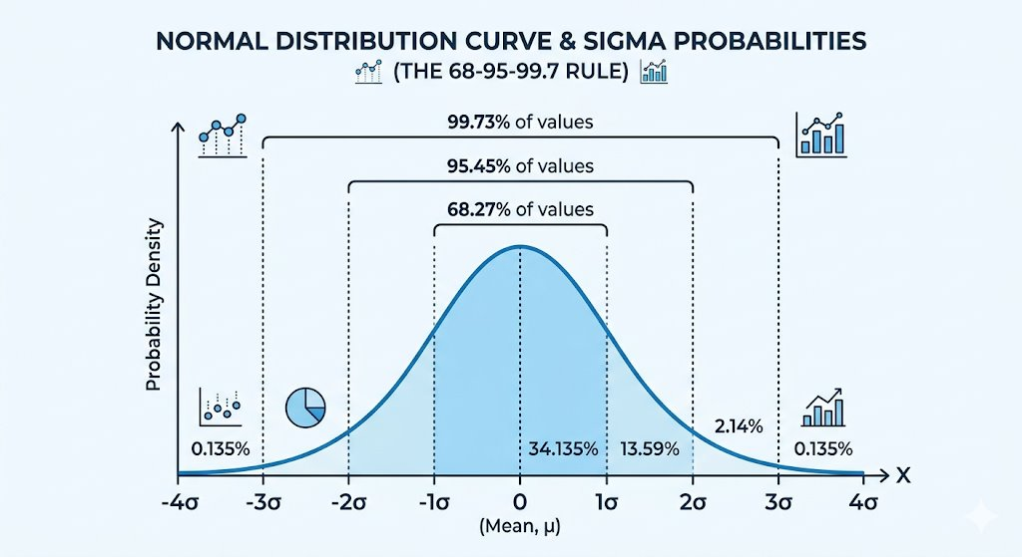

Slide 8
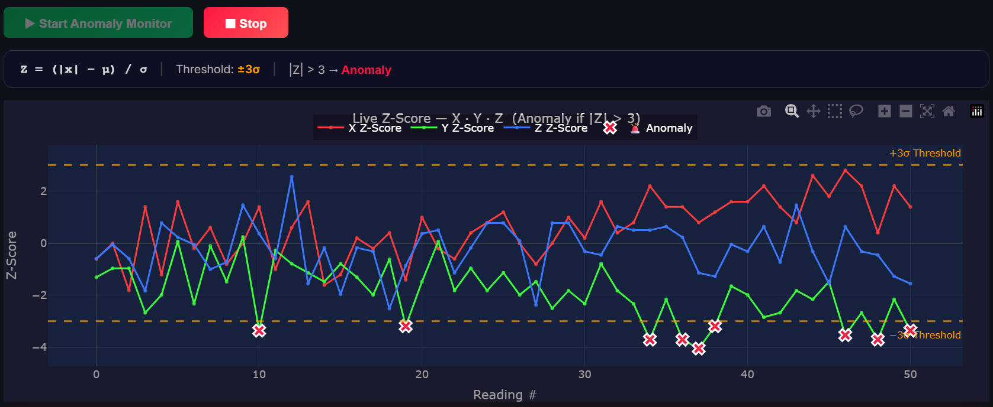
RESULTS
Results & Analysis
System performance across calibration, monitoring, and anomaly detection
9 / 12

Slide 9
LIVE SYSTEM DEMO
Screen Share — Real-Time Motor Diagnostic Dashboard
01
Calibration Phase
02
Real-Time Monitoring
Start the motor in verified healthy state. Record 1000-sample baseline. System computes μ and σ per axis and displays the normal distribution histogram.
Observe the live tri-axial vibration telemetry on the scrolling oscilloscope display. All Z-scores remain within ±3σ safe zone during normal operation.
03
Anomaly Induction
04
Alert & Recovery
Apply controlled mechanical load or strike the motor casing. Observe the Z-score spike beyond the 3σ threshold and the immediate critical alert activation.
Dashboard flashes red. Z-score returns to safe zone after load removal, demonstrating system responsiveness and self-recovery without restart.
10 / 12

Slide 10
ARCHITECTURE
System Architecture
End-to-end hardware–software pipeline
1
2
3
4
Hardware Layer
Transport Layer
Backend Layer
Frontend Layer
ESP32 + MPU-6050 IMU
Sampling @ 100 Hz
USB Serial / UART
Data Streaming
Python FastAPI
Z-Score Engine
Streamlit + Plotly.js
Real-Time Dashboard
Vibration data sampled tri-axially at 100 Hz
Byte-packed serial stream to host machine
Statistical normalization + anomaly detection
Live telemetry + alert notification system
4 / 12

Slide 11
HARDWARE
Hardware Components
Embedded sensor node design and specifications
ESP32 Microcontroller
MPU-6050 IMU
Communication Protocol
Central Processing Unit
Inertial Measurement Unit
Data Transmission Interface
Dual-core Xtensa LX6 @ 240 MHz
4 MB Flash / 520 KB SRAM
Integrated Wi-Fi & Bluetooth 4.2
USB-to-Serial via CP2102
3-axis MEMS Accelerometer (±2/4/8/16 g)
3-axis MEMS Gyroscope (±250–2000 °/s)
I²C / SPI Interface @ 400 kHz
On-chip 16-bit ADC + DMP
UART Serial @ 115200 baud
Structured byte-pack framing
FastAPI serial listener thread
Error-checked packet validation
5 / 12

Slide 12
SOFTWARE
Software Stack & Implementation
Backend, frontend, and communication architecture
Backend — FastAPI
Asynchronous serial listener thread reads ESP32 data stream
Real-time Z-Score computation against calibrated μ and σ per axis
REST + WebSocket endpoints serve live telemetry to frontend
Stores rolling 1000-sample calibration buffer in memory
Frontend — Streamlit + Plotly.js
Plotly.react() client-side rendering for zero-flicker live charts
Scrolling 100-point telemetry window mimicking oscilloscope display
Normal distribution histogram of calibration data with ±3σ overlays
Flashing red critical alert banner triggered on |Z| > 3 detection
Python 3.11
FastAPI 0.104
Streamlit 1.28
Plotly.js 5.x
PySerial
NumPy
Pandas
8 / 12

Slide 13
CONCLUSION
Conclusion & Future Scope
Summary of outcomes and planned enhancements
Conclusions
ML Integration
Supplement Z-Score with Isolation Forest or LSTM autoencoders for non-stationary fault patterns.
Successfully implemented a complete hardware-to-dashboard predictive maintenance pipeline.
Z-Score algorithm with 3σ threshold demonstrated high sensitivity and near-zero false negatives.
Zero model training requirement enables rapid deployment across heterogeneous machinery.
Client-side Plotly.js rendering achieved real-time visualization with negligible latency.
System architecture is modular, scalable, and extensible to multi-machine monitoring.
Wireless OTA
Replace serial UART with Wi-Fi/MQTT for untethered industrial IoT deployment.
Multi-Node Fleet
Scale monitoring to concurrent multi-motor fleet with centralized anomaly dashboard.
11 / 12

Slide 14
Thank You
Questions & Discussion Welcome
References
[1] Montgomery, D. C. (2019). Introduction to Statistical Quality Control. John Wiley & Sons.
[2] Mobley, R. K. (2002). An Introduction to Predictive Maintenance. Butterworth-Heinemann.
[3] FastAPI Documentation (2023). https://fastapi.tiangolo.com/
[4] Plotly.js Scientific Graphing Library. https://plotly.com/javascript/
Machine Maintenance & Motor Diagnostic System · B.Tech Second Year Minor Project
12 / 12

